Slide 1
Chapter 5 Analysis
Evan Myers, Matthew Williams, Ian Neer, Dakota Nations, Darius Fiaillo, Alec Cromer, Kevin Mitchell, Brisaac Johnson

Slide 2
5.4.12 Analysis Summary
Requirements Elicitation is highly iterative and incremental
Functionality is sketched and proposed to the client
Prototypes
Nonfunctional requirements
Clients adds requirements throughout process
Analysis must be orderly to manage the complexity of the information

Slide 3
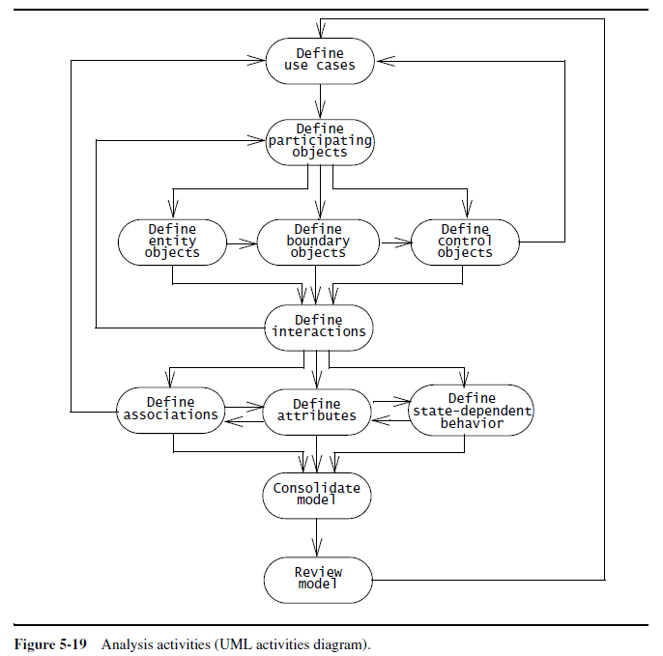
UML Activities Diagram

Slide 4
5.4.12 Analysis Summary
The users, developers, and client are involved in developing an initial use case model.
Identify concepts and build a glossary of participating objects
The developers classify the participating objects into entity, boundary, and control objects
Then the developers construct sequence diagrams to identify any missing objects
Definitions of associations, attributes, and state-dependent behavior
Use cases are then modified to account for any changes in functionality
Repeat process incrementally for new use cases.

Slide 5
5.4.12 Analysis Summary
Consolidate Model- the developers solidify the model by introducing qualifiers and generalization relationships and suppressing redundancies
Review Model- the client, users, and developers examine the model for correctness, consistency, completeness, and realism
The project schedule should plan for multiple reviews to ensure high-quality requirements and to provide opportunities to learn the requirements activity.
When most of the modifications are cosmetic, system design should proceed.

Slide 6
5.5 Managing Analysis
The primary challenge in managing the requirements in such a project is to maintain consistency while using so many resources.
The requirement analysis document describes a single coherent system understandable to single person

Slide 7
5.5.1 Documenting Analysis
Requirements Analysis Document (RAD)- documents requirements elicitation and analysis documents
RAD Section 3.5.3 (Object models)- documents in detail all the objects we identified, their attributes, and, when we used sequence diagrams, operations
Textual definitions
Relationships amongst objects
Documented with Class Diagrams
RAD Section 3.5.4 (Dynamic models)- documents the behavior of the object model in terms of state machine diagrams and sequence diagrams
Represent complex behaviors

Slide 8
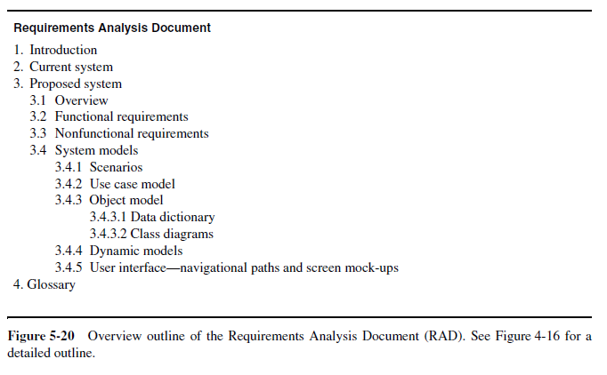
Requirements Analysis Document

Slide 9
5.5.5 Client Sign-Off
The clients and the developers agree about the functions and features the system will have and:
A list of priorities, a revision process, a list of criteria, and a schedule and budget
Prioritizing system functions allows the developer to understand better the client’s expectations
Afterwards, requirements are baselined and used to refine cost estimate
Acceptance of the requirements analysis document is critical

Slide 10
5.6 ARENA Case Study
In ARENA, each legitimate LeagueOwner is represented with an object that is used to store data specific to that LeagueOwner, such as her contact information, the leagues that she manages, and so on.

Slide 11
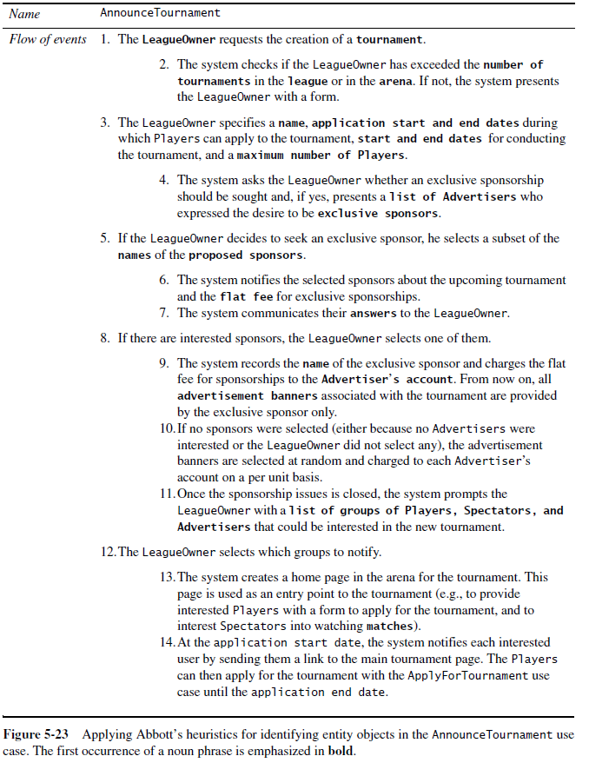

Slide 12
5.6.1 Identifying Entity Objects
Attributes represent a single property
Attributes have simple types.
Complex types would be how Objects relate to one another
Nouns referring to collections are associations, often with implicit ends.
Definitions are very important for use cases
Clarity for terms
Game vs. Match

Slide 13
5.6.2 Identifying Boundary Objects
Boundary objects represent the interface between the system and the actors.
They are identified from the use cases and usually represent the user interface at a coarse level
Boundary objects represent concepts such as windows, forms, or hardware artifacts such as workstations. This enables stakeholders to visualize where functionality is available in the system.

Slide 14
5.6.3 Identifying Control Objects
Control objects represent the coordination among boundary and entity objects.
Commonly, a single control object is created at the beginning of the use case and accumulates all the information needed to complete the use case.
The control object is then destroyed with the completion of the use case.

Slide 15
5.6.4 Modeling Interactions Among Objects
Sequence diagrams- objects go on top row
Sequence- left-most the initiating actor, followed by the boundary object responsible for initiating the use case, followed by the main control object, and the entity objects
Any other participating actors and their corresponding boundary objects are on the right of the diagram.
Class diagrams should depicts the associations among the boundary, control, and selected entity objects associated with the use case
Class diagrams should invoke more questions in interviews with the client

